Slide 1
2023 RFI Survey Toolkit Results from the 2023 CBO-Health Care Contracting Survey

Slide 2
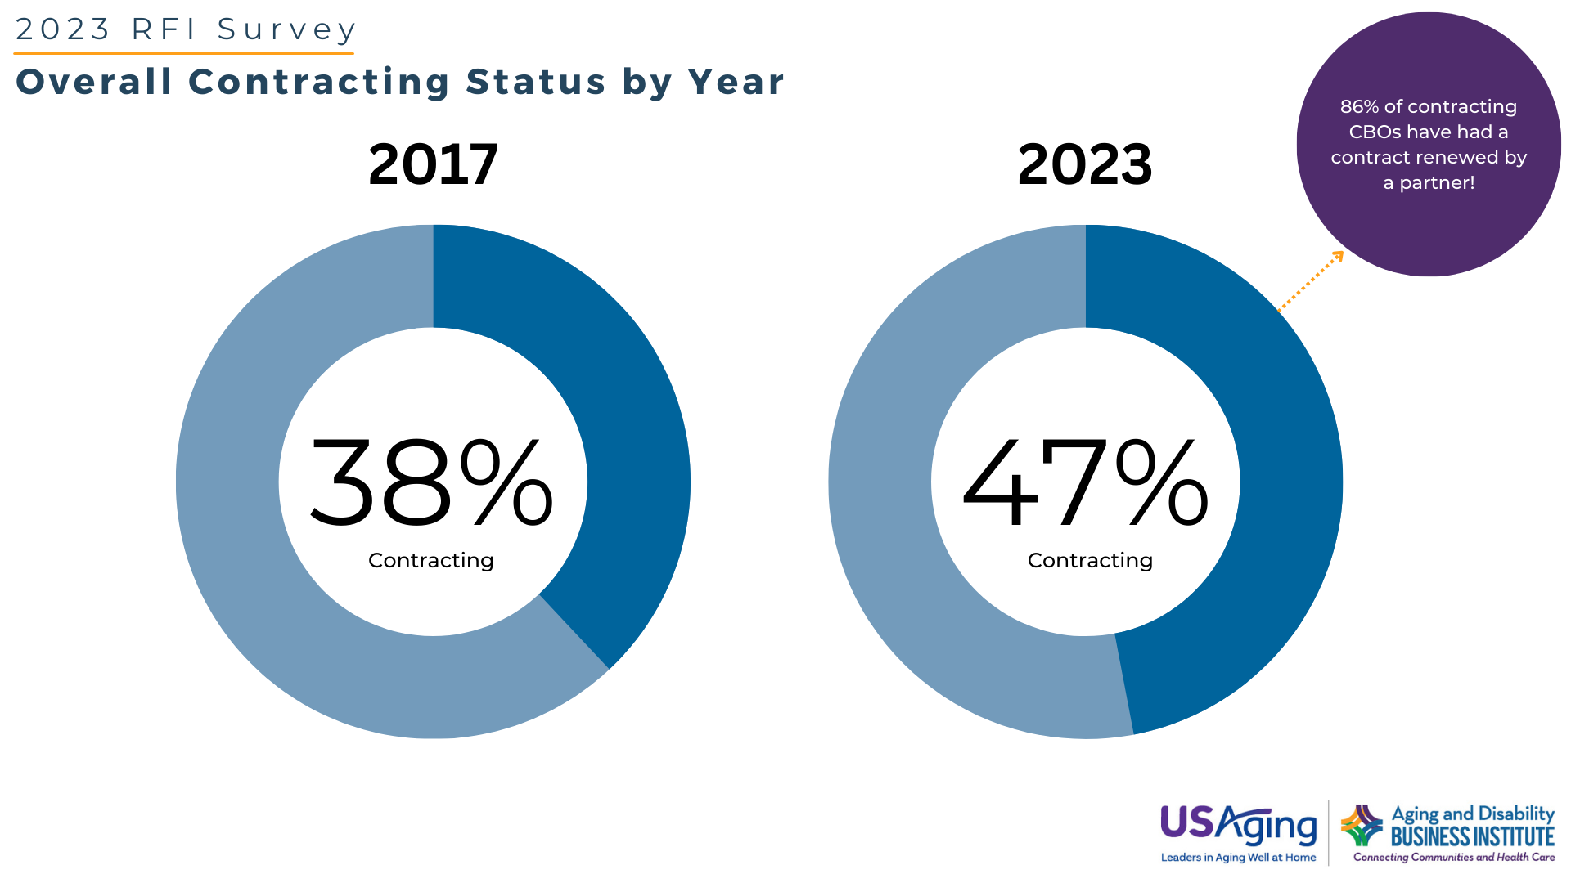
The data used in this graph was collected through a survey conducted by Scripps Gerontology Center at Miami University on behalf of the Aging and Disability Business Institute, led by USAging. For more information, visit https://bit.ly/Nexus-of-Social-Care
Notes:
This question was asked of all respondents.
2023: As a reminder, for the purposes of this survey, we are interested in contracts in which your CBO or network receives (or will receive) payment from a health care entity.
Does your organization currently participate in a contract to provide services or programs with or on behalf of a health care entity? Select only one. (n=514)
Thinking about your active contract(s) with health care entities, have any of them been renewed by the contracting organization? (n=229)
2017: Does your organization currently have a contract to provide services or programs with or on behalf of a health care entity (Check one.)
n=593

Slide 3
The data used in this graph was collected through a survey conducted by Scripps Gerontology Center at Miami University on behalf of the Aging and Disability Business Institute, led by USAging. For more information, visit https://bit.ly/Nexus-of-Social-Care
Notes:
This question was asked only of CBOs with contracts.
A network is defined as a coordinated group of community-based organizations that pursues a regional, statewide, or multi-state contract with a health care entity.
2023: Did you enter into any of your contracts with health care entities as part of a network? (n=228)
2017: Did you enter into this contract as an individual organization or as part of a network? (n=223)
A network is defined as a group of community-based organizations that pursues a regional or statewide contract with a payer as joint venture.
The following information about networks includes information collected from hubs that are both currently contracting as well as not yet contracting. In total, 29 CCHs were identified from all survey respondents. While 29 CCHs were identified, specifics about the networks were collected from only 28 of those CCHs. The information below reflects the responses from those 28 CCHs, regardless of their current contracting status.
Number of contracts currently held by your network (n=26)
Does your hub have a separate legal structure such as an LLC or 501c3? (n=28)
Does your hub have formal data sharing agreements with your network members? (n=28)
How is the administrative infrastructure of the network funded? Check all that apply. (n=28)

Slide 4
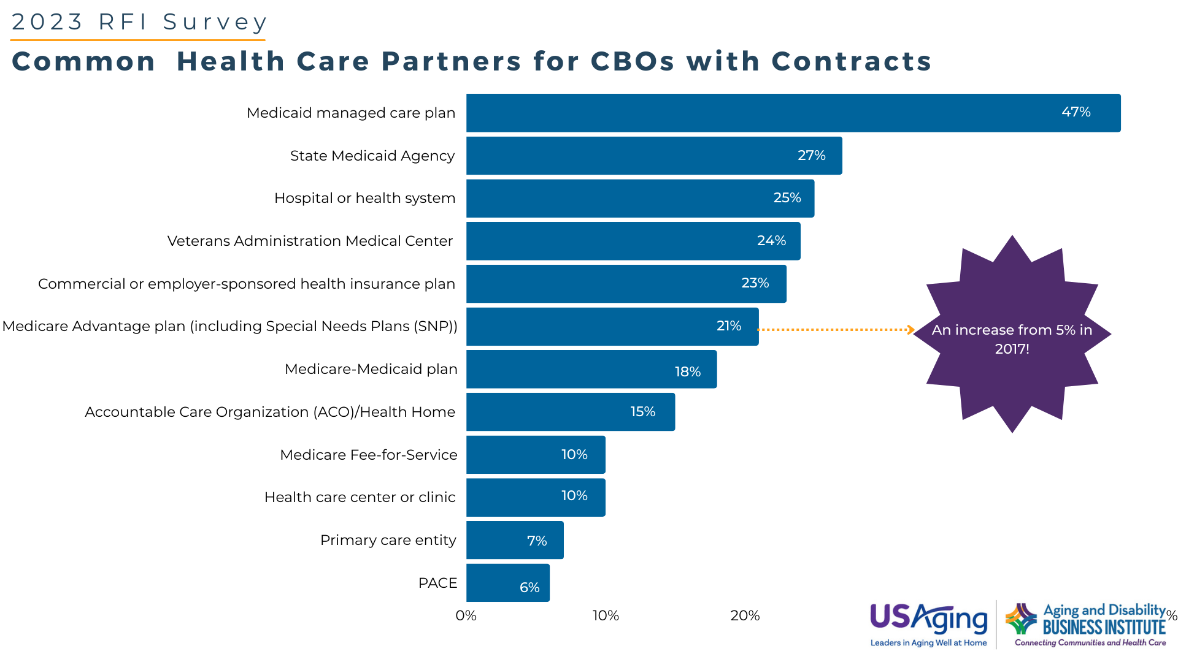
The data used in this graph was collected through a survey conducted by Scripps Gerontology Center at Miami University on behalf of the Aging and Disability Business Institute, led by USAging. For more information, visit LINK
The data used in this graph was collected through a survey conducted by Scripps Gerontology Center at Miami University on behalf of the Aging and Disability Business Institute, led by USAging. For more information, visit https://bit.ly/Nexus-of-Social-Care
Notes:
Thinking about all of your contracts with health care entities, please indicate whether you participate in a contract that includes any of the following plans, payers, or providers. Select all partners with whom you have a contract. (n=220)
This question was asked only of respondents with contracts.
2017: Which of the following best describes the health care entity (or entities) with which you have this contract? (Check all that apply.) (n=223) The agency contracts with one of the following health care entities in at least one of their (up to) three contracts.

Slide 5
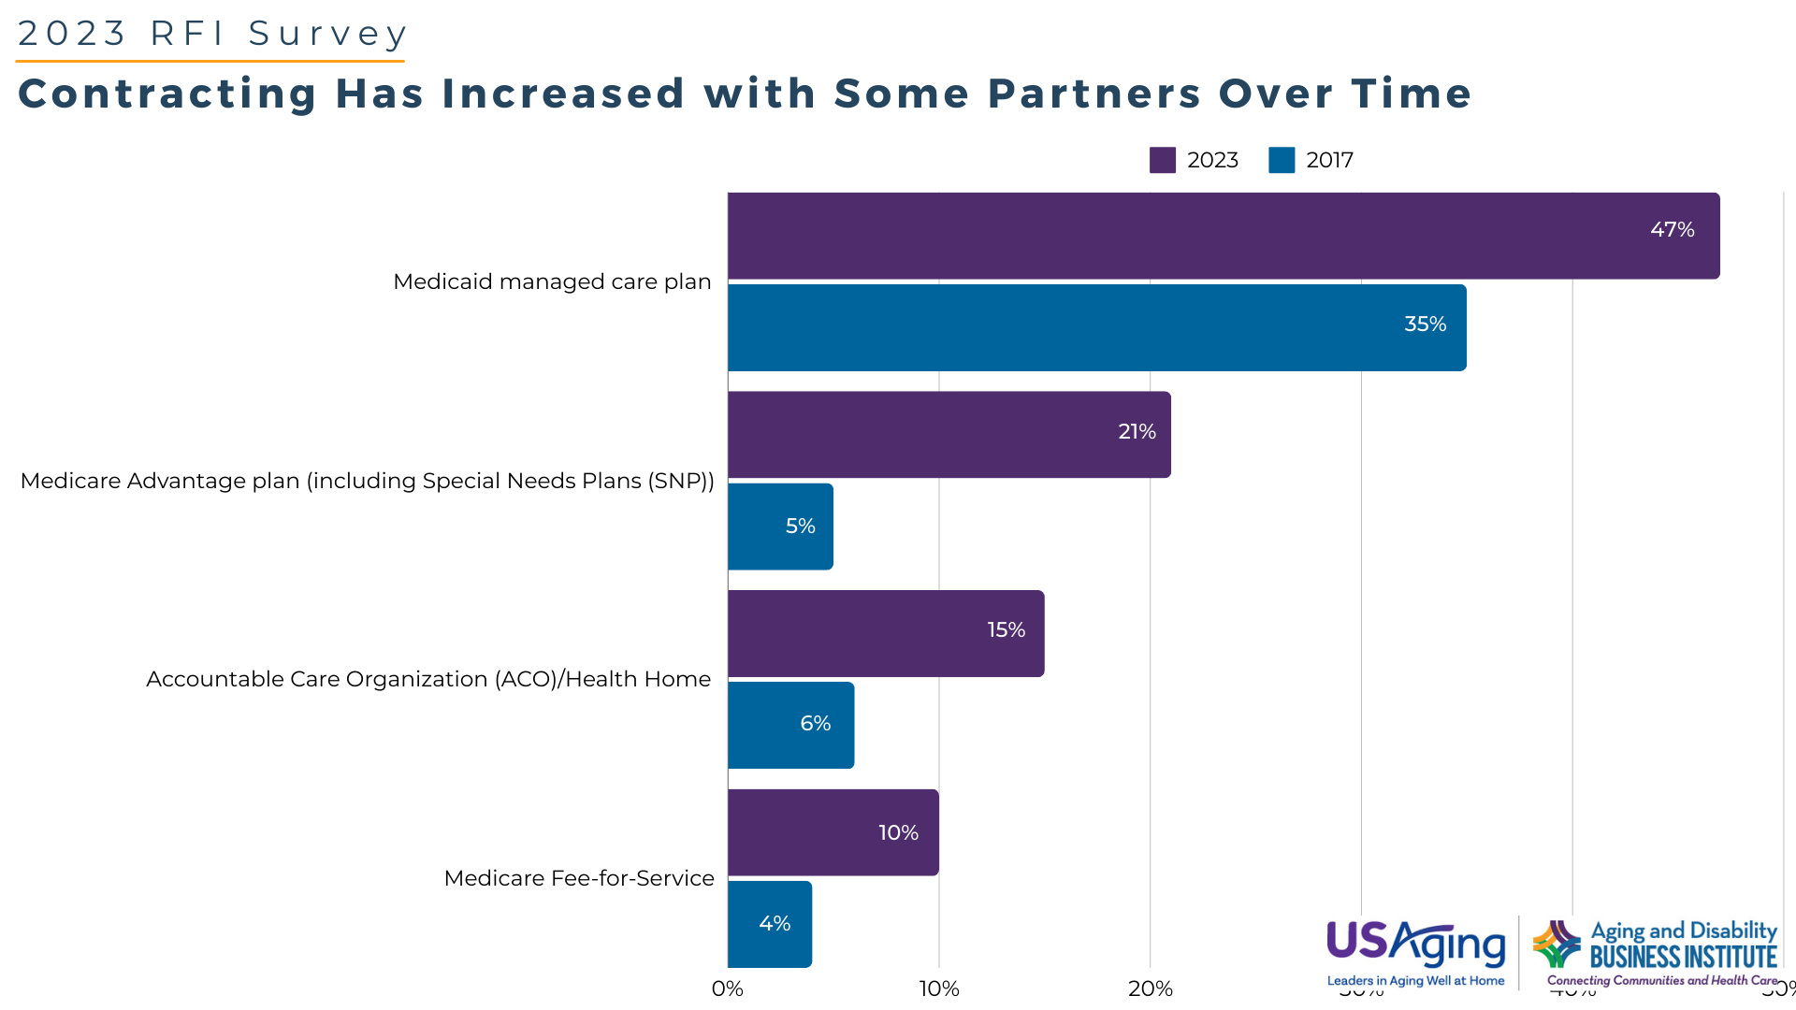
The data used in this graph was collected through a survey conducted by Scripps Gerontology Center at Miami University on behalf of the Aging and Disability Business Institute, led by USAging. For more information, visit https://bit.ly/Nexus-of-Social-Care
Notes:
This question was asked only of respondents with contracts.
2023: Thinking about all of your contracts with health care entities, please indicate whether you participate in a contract that includes any of the following plans, payers, or providers. Select all partners with whom you have a contract. (n=220)
2017: Which of the following best describes the health care entity (or entities) with which you have this contract? (Check all that apply.) (n=223) The agency contracts with one of the following health care entities in at least one of their (up to) three contracts.

Slide 6
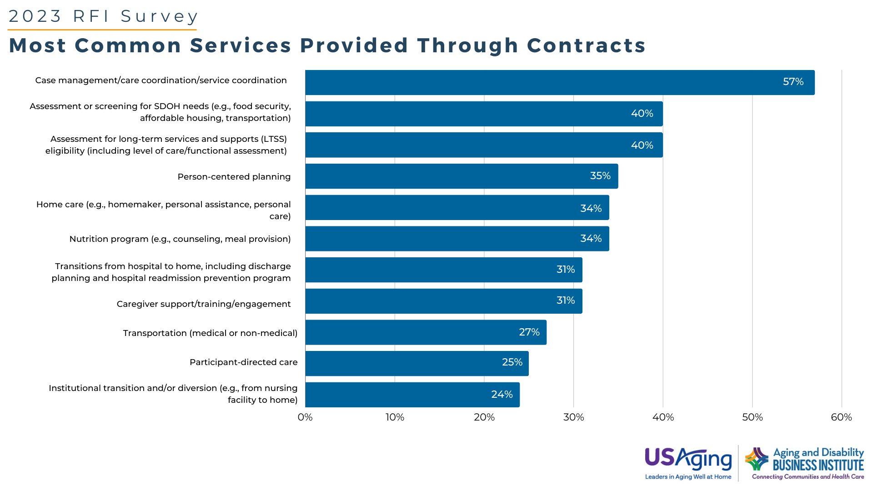
The data used in this graph was collected through a survey conducted by Scripps Gerontology Center at Miami University on behalf of the Aging and Disability Business Institute, led by USAging. For more information, visit https://bit.ly/Nexus-of-Social-Care
Notes:
This question was asked only of respondents with contracts.
2023: Please indicate whether you offer these services or programs through any of your contracts with a health care entity. (Select all that apply) (n=223)
2017: For those agencies that have contracts, they offer the following services in at least one of their (up to three) contracts: (n=223)

Slide 7
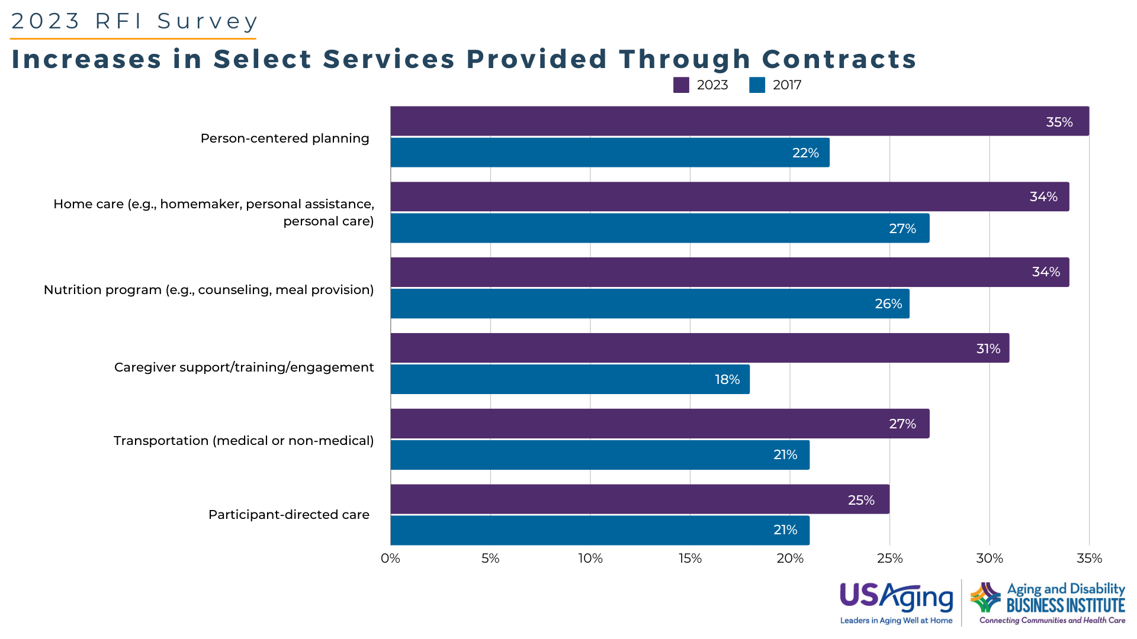
The data used in this graph was collected through a survey conducted by Scripps Gerontology Center at Miami University on behalf of the Aging and Disability Business Institute, led by USAging. For more information, visit https://bit.ly/Nexus-of-Social-Care
Notes:
This question was asked only of respondents with contracts.
2023: Thinking about all of your contracts with health care entities, please indicate whether you participate in a contract that includes any of the following plans, payers, or providers. Select all partners with whom you have a contract (n=220)
2017: Please indicate whether you offer these services or programs through any of your contracts with a health care entity. (Select all that apply)
For those agencies that have contracts, they offer the following services in at least one of their (up to three) contracts: (n=223)

Slide 8
The data used in this graph was collected through a survey conducted by Scripps Gerontology Center at Miami University on behalf of the Aging and Disability Business Institute, led by USAging. For more information, visit https://bit.ly/Nexus-of-Social-Care
Notes:
This question was asked only of respondents with contracts.
2023: Which of the following changes related to contracting with health care entities have been most significant for your organization? (Check up to five changes). (n=187)

Slide 9
The data used in this graph was collected through a survey conducted by Scripps Gerontology Center at Miami University on behalf of the Aging and Disability Business Institute, led by USAging. For more information, visit https://bit.ly/Nexus-of-Social-Care
Notes:
This question was asked only of respondents with contracts.
2023: Thinking about all of your contracting efforts to date, if you could inform other agencies working toward contracting of the biggest challenges you faced in establishing the contract, which of the following challenges would you select?
From the below list of challenges, please check up to five in the first column. In the second column, please select the five biggest challenges that you continue to face in your contract relationships.
Was a challenge in establishing the contract (n=176)
Continues to be a challenge in the contract relationship (n=174)

Slide 10
The data used in this graph was collected through a survey conducted by Scripps Gerontology Center at Miami University on behalf of the Aging and Disability Business Institute, led by USAging. For more information, visit https://bit.ly/Nexus-of-Social-Care
Notes:
This question was asked only of respondents with contracts.
2023: Please indicate which of the following payment models are used in ANY of your contracts with health care entities. Check all that apply. (n=208)
2017: Which of the following best describes the current payment model for this contract? (Select one.) The following payment models are used by an agency in at least one of their (up to 3) contracts.(n=220)

Slide 11
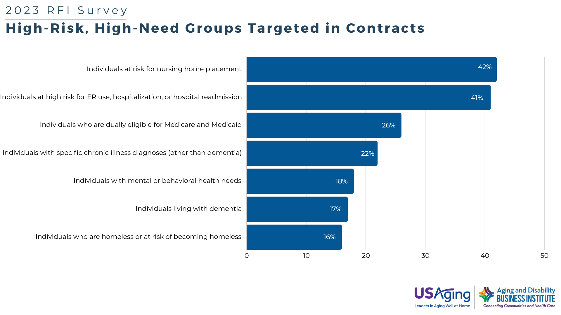
The data used in this graph was collected through a survey conducted by Scripps Gerontology Center at Miami University on behalf of the Aging and Disability Business Institute, led by USAging. For more information, visit https://bit.ly/Nexus-of-Social-Care
Notes:
This question was asked only of respondents with contracts.
2023: Which of the following populations are eligible for services through your contracts with health care entities? Check all that apply. (n=220)

Slide 12
The data used in this graph was collected through a survey conducted by Scripps Gerontology Center at Miami University on behalf of the Aging and Disability Business Institute, led by USAging. For more information, visit https://bit.ly/Nexus-of-Social-Care
Notes:
This question was asked only of respondents with contracts.
2023: We would like to learn more about your contracts with specific health care partners. Please indicate which services you offer through your contracts with the entities below.
Medicaid MCO n=103
Medicare Advantage n=45
Medicare-Medicaid duals plans n=40

Slide 13
The data used in this graph was collected through a survey conducted by Scripps Gerontology Center at Miami University on behalf of the Aging and Disability Business Institute, led by USAging. For more information, visit https://bit.ly/Nexus-of-Social-Care
Notes:
This question was asked only of respondents with contracts.
2023: We would like to learn more about your contracts with specific health care partners. Please indicate which services you offer through your contracts with the entities below.
Hospital or health system n=55
ACO n=33

Slide 14
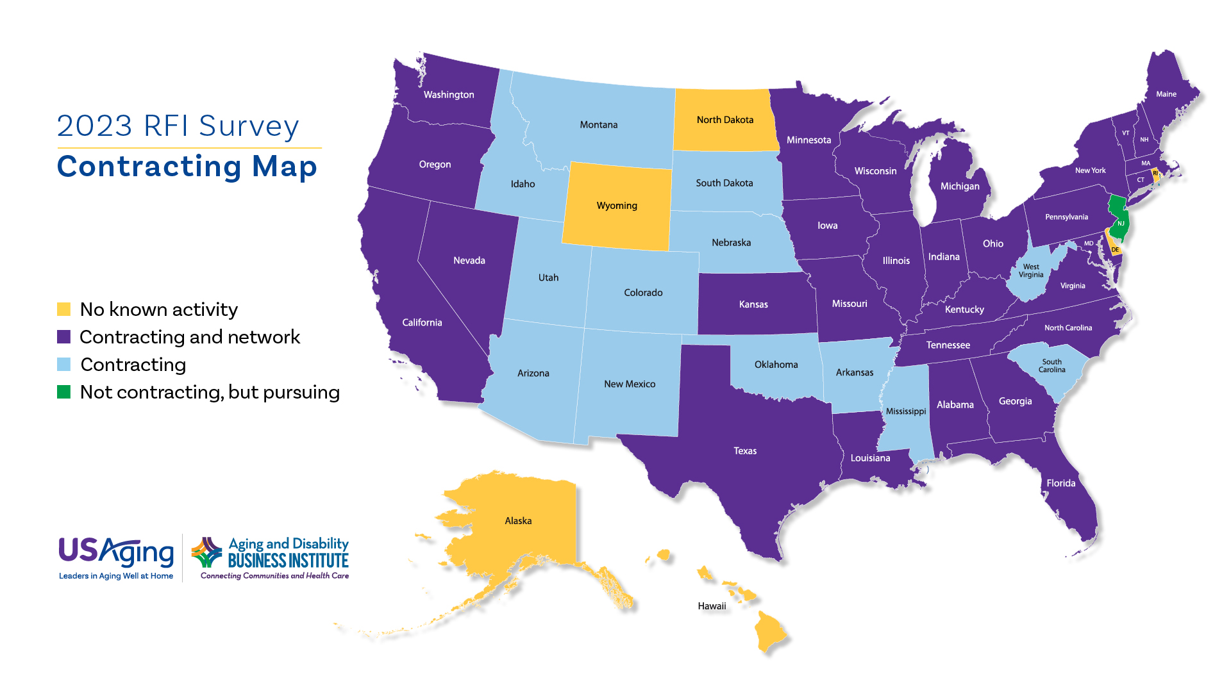
The data used in this graph was collected through a survey conducted by Scripps Gerontology Center at Miami University on behalf of the Aging and Disability Business Institute, led by USAging.
The data used in this graph was collected through a survey conducted by Scripps Gerontology Center at Miami University on behalf of the Aging and Disability Business Institute, led by USAging. For more information, visit https://bit.ly/Nexus-of-Social-Care
Notes:
This question was asked of all respondents.
2023: As a reminder, for the purposes of this survey, we are interested in contracts in which your CBO or network receives (or will receive) payment from a health care entity.
Does your organization currently participate in a contract to provide services or programs with or on behalf of a health care entity? Select only one. (n=514)
A network is defined as a coordinated group of community-based organizations that pursues a regional, statewide, or multi-state contract with a health care entity.
2023: Did you enter into any of your contracts with health care entities as part of a network? (n=228)

